Slide 1
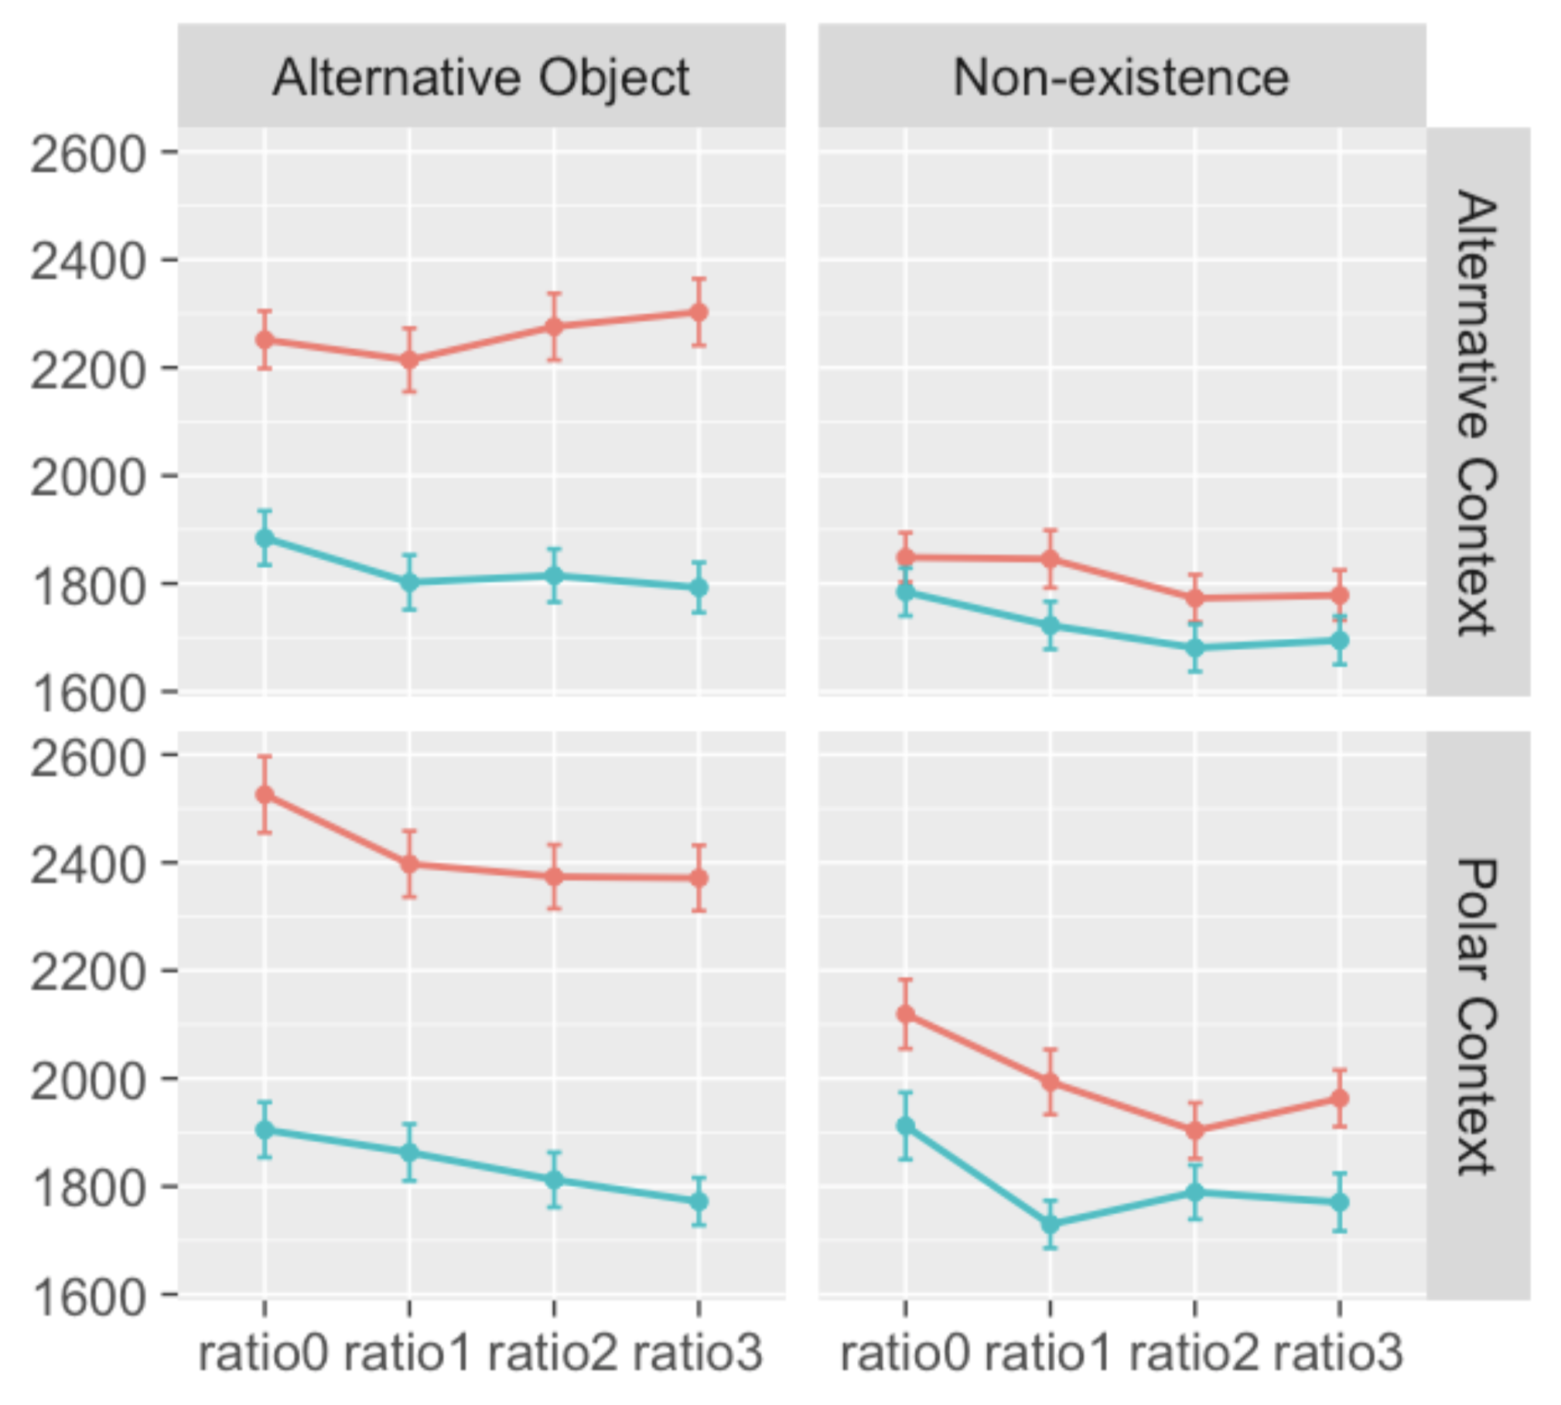
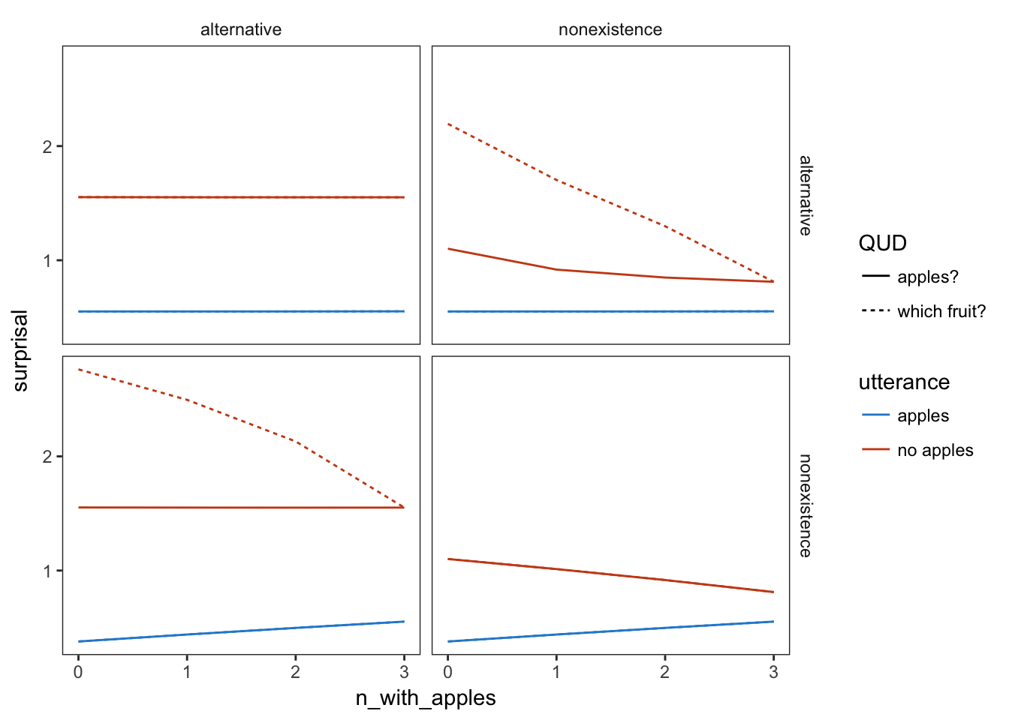
Referent
Alt
None
Which fruit?
Which fruit?
Alt
X context ↑negation
✓ context ↓negation
Context
Apples?
Apples?
None
X context - negation
✓ context - negation

